Slide 1
Dial in (Main): (914) 614-3221
Dial in (Alt): (914) 339-0024
Attendee Access Code: 571-970-310
Slides in “Handout” Tab
Process to Resume
Research at VA Facilities
Rachel Ramoni - Chief Research and Development Officer
Office of Research and Development (10X2)

Slide 2

Objectives
Review facility considerations and investigator risk
assessment for resuming research activities
Review facility considerations and investigator risk
assessment for resuming research activities
Identify issues related to resuming animal facility
operations
ORD Webinar- June 2020
2

Slide 3
Agenda
1
Resuming in-person human
subjects research (5 minutes) – Dr.
Rachel Ramoni, CRADO
3
Resumption of normal animal
facility operations (10 minutes) –
Dr. Mike Fallon, CVMO
2
Evaluation of facility
considerations and investigator
risk assessment (15 minutes) – Dr.
Molly Klote, Director, ORPPE
4
Challenges facilities are facing in
resuming activities (30 minutes)
5
Questions
ORD Webinar- June 2020
3

Slide 4
Resuming In-Person Human
Subjects Research
ORD Webinar- June 2020
4

Slide 5
Bottom line up front
March 17 - Office of Research and Development
(ORD) placed an administrative hold on in-person
human subjects research
June 2 - ORD will issued a memo to research offices
outlining required and recommended steps to
resume in-person research.
Would like to inform you about the process and
give you the opportunity to ask questions.
ORD Webinar- June 2020
5

Slide 6
Administrative hold
Put into place by ORD on March
17
In-person
Non-critical
ORD-funded
Non-COVID
Human subjects
Investigators were encouraged to identify virtual mechanisms to interact with their participants.
ORD Webinar- June 2020
6

Slide 7
For the rest of this
presentation, I'll just call
it “in-person research”.
ORD Webinar- June 2020
7

Slide 8
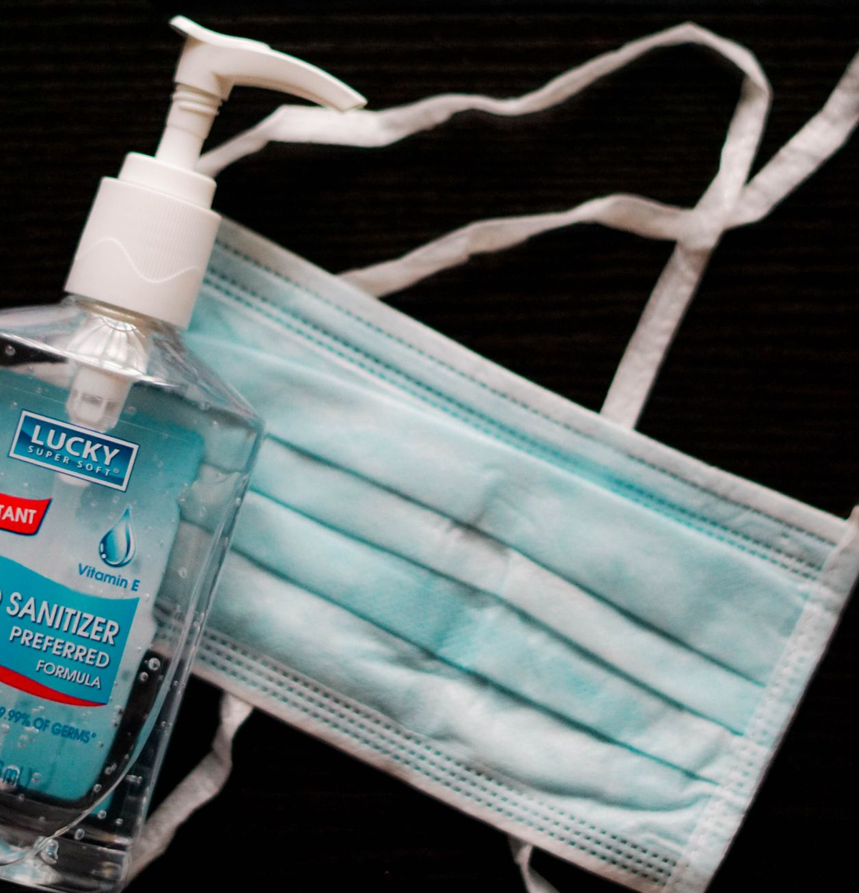
Rationale
Health and safety of research participants,
research staff, and everyone at the VAMC
Minimize PPE requirements
Research staff availability for COVID-related
research and clinical requirements
ORD Webinar- June 2020
8

Slide 9
Consequences
Benefits of participation in research
Research helps to attract and retain clinicians
Learning healthcare system depends on active
research program
Impacts on research budget and productivity
ORD Webinar- June 2020
9

Slide 10
Requirement for site to resume in-person research
COVID operations group, incident response group,
or chief of staff sign-off on “Facility Sign Off on
Resumption of In-Person Research Activities” form.
Signed form emailed to ORD.
ORD releases administrative hold on in-person
research at that site.
ORD Webinar- June 2020
10

Slide 11
Recommended steps
We are providing research offices an algorithm and form to
capture the risk assessment for an individual study.
ORD-funded and non-ORD-funded studies should be assessed.
We recommend that the research office review the complete set
of risk assessment forms prior to creating a plan to resume
in-person research based upon importance to Veterans and
impact on the facility.
We recommend that the COVID operations group, incident
response group, or chief of staff review the plan prior to signing
the “Facility Sign Off on Resumption of In-Person Research
Activities”.
ORD Webinar- June 2020
11

Slide 12
Central IRB protocols
Studies that notified the CIRB that they were
changing research procedures for the safety of the
subjects:
If you plan to stop the new procedures (remote/telehealth, etc…) and revert back to the originally approved study procedures, no notification is necessary.
If you plan to continue the new procedures, you have 30 days to file an amendment with the CIRB to have the procedures approved for the study.
ORD Webinar- June 2020
12

Slide 13
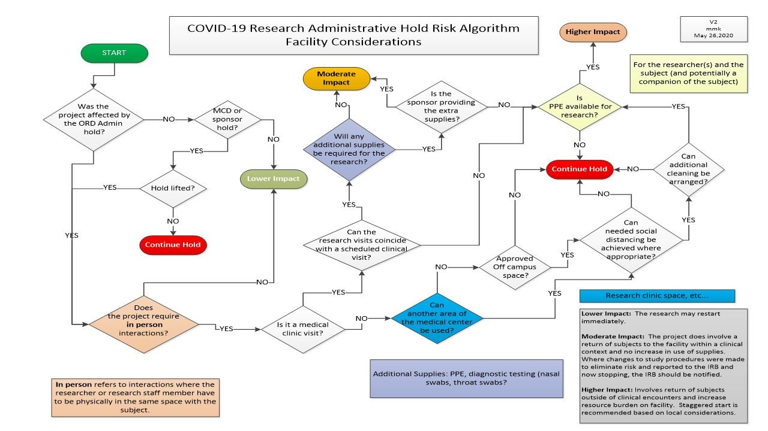

Slide 14
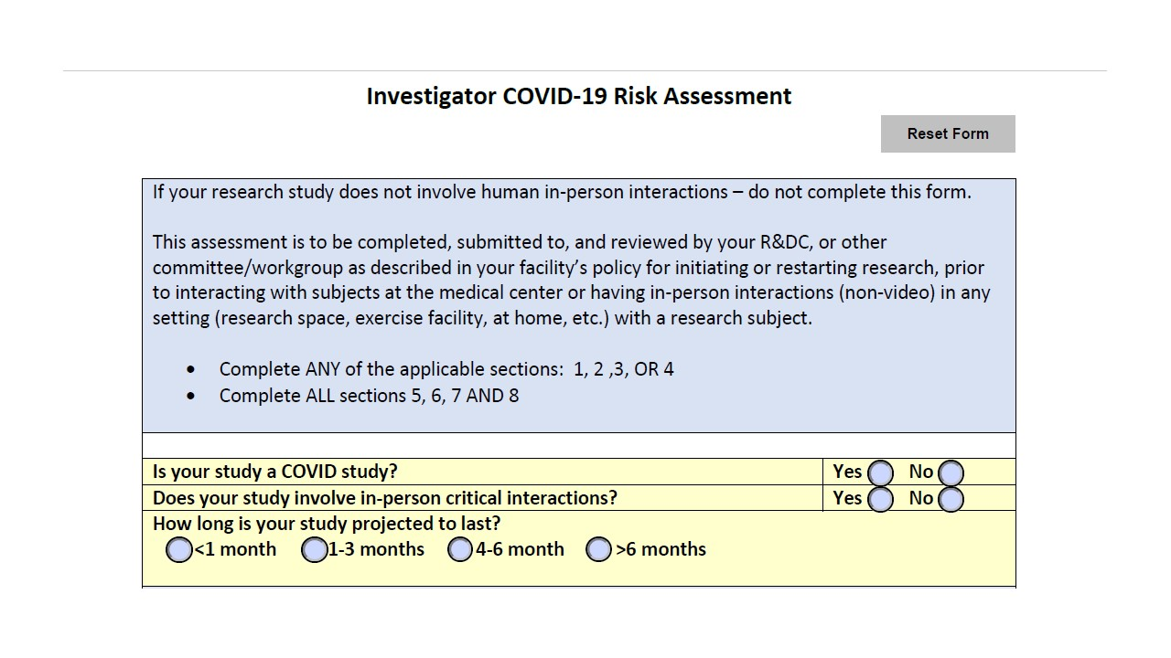

Slide 15
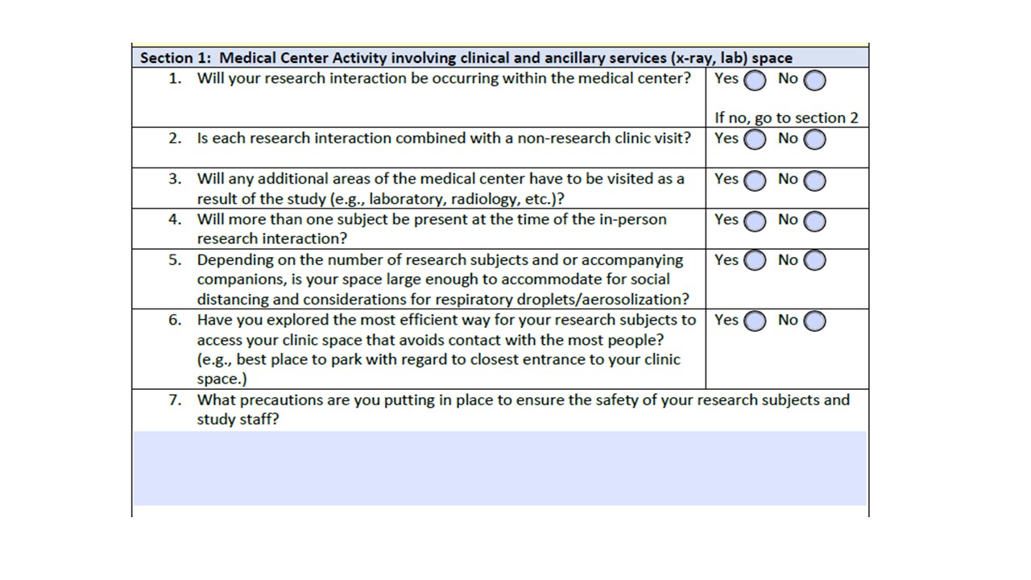

Slide 16
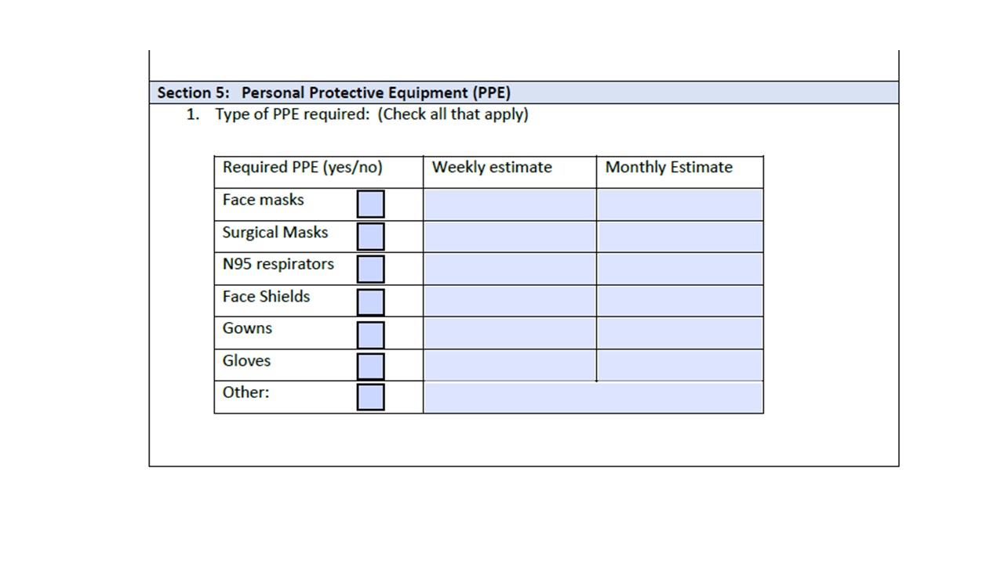

Slide 17
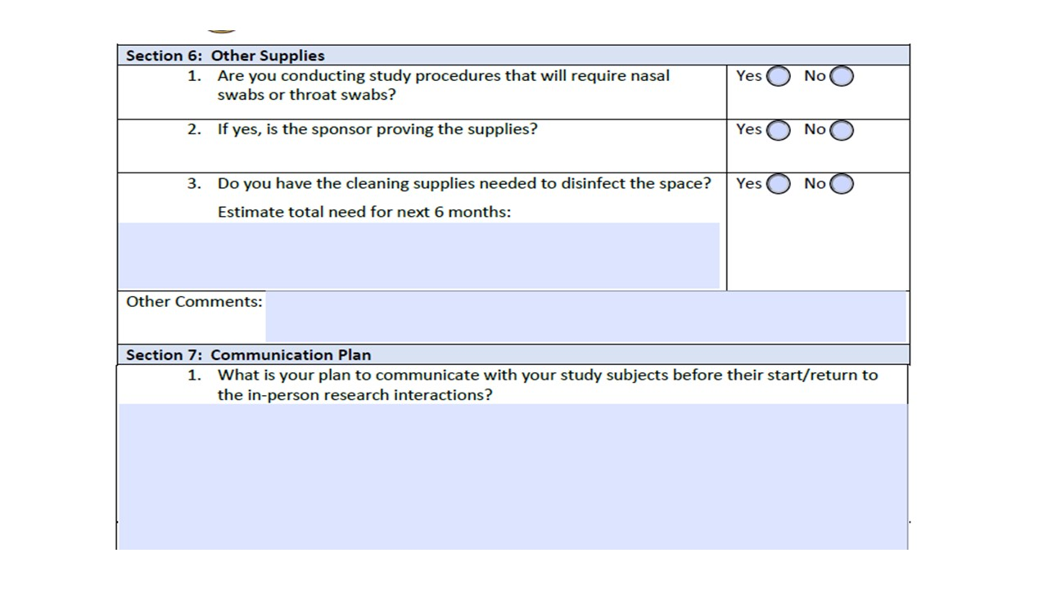

Slide 18
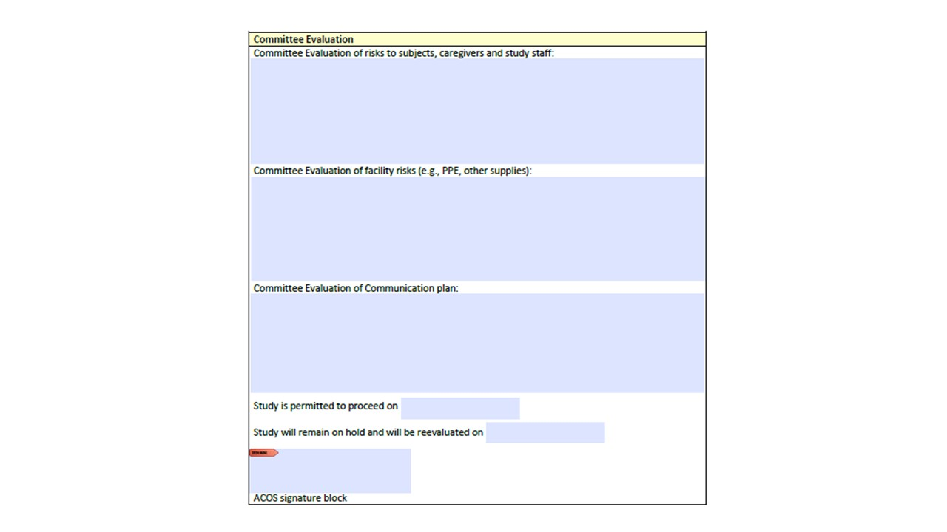

Slide 19
